Slide 1
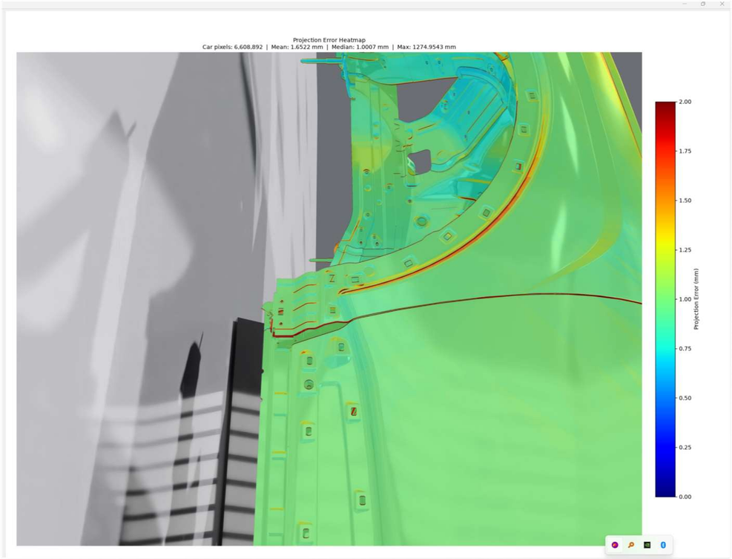
HYUNDAI MOTOR GROUP · INNOVATION CENTER SINGAPORE
Quantifying 3D
Localization Error
Pixel-rounding and camera-pose sensitivity in the
2D image-based inline CAD-matching MVP
Projection-error heatmap · median 1.0 mm
Camera Extrinsics Calibration · Car Body Defect Localization Workflow
haoyang.duan · Sprint 35 · August 2026

Slide 2
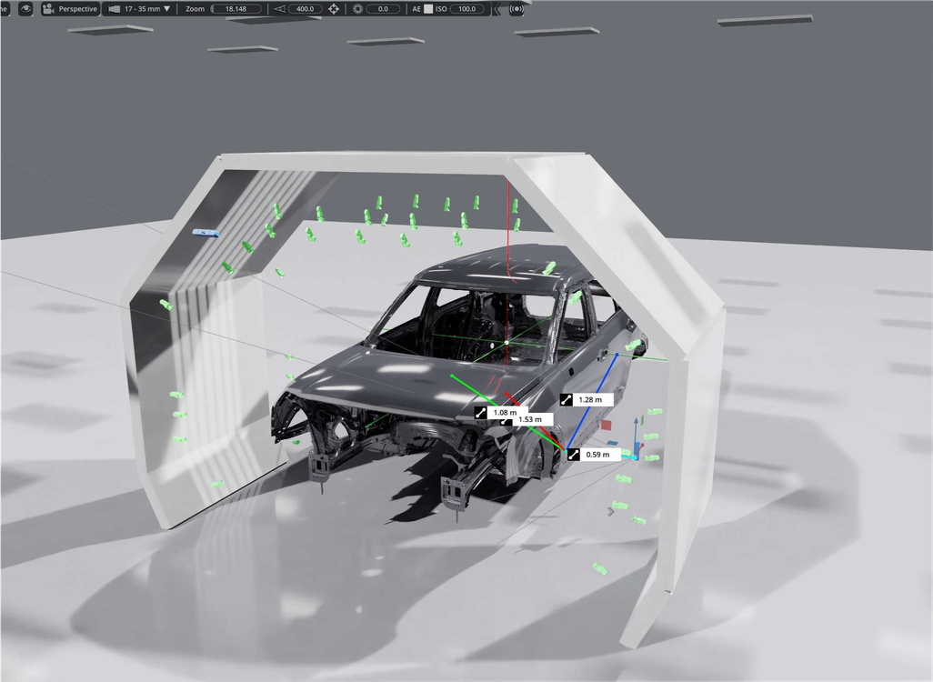

CONTEXT
Why localization accuracy matters
The MVP localizes a target point on the car body in 3D from calibrated camera images and the CAD mesh — the foundation for inline defect localization.
Reaching millimetre-level accuracy means knowing where error comes from. Two independent geometric sources are isolated and quantified in simulation:
01
Pixel-rounding error
Snapping the sub-pixel projection to an integer pixel.
Car-pose sensitivity
Isaac Sim capture cell — car body ringed by virtual cameras
02
Error propagated from an imperfect car-pose estimate.

Slide 3
SCOPE
Two studies, one question: where does the error come from?
1
Ray Projection &
Pixel-Rounding Error
2
Car-Pose
Sensitivity Heatmap
How much 3D error comes purely from rounding a sub-pixel projection to an integer pixel?
How much 3D error arises when the estimated car pose deviates from the true pose?
Fully geometric — no image detection
Per-pixel error over 6-DOF deviation
Swept across image resolution
4 camera viewpoints, 50 steps/axis
Result: an error ceiling, not a floor
Result: rotation is the dominant driver

Slide 4
01
Ray Projection &
Pixel-Rounding Error
Math, not detection — isolating the single geometric error source.

Slide 5
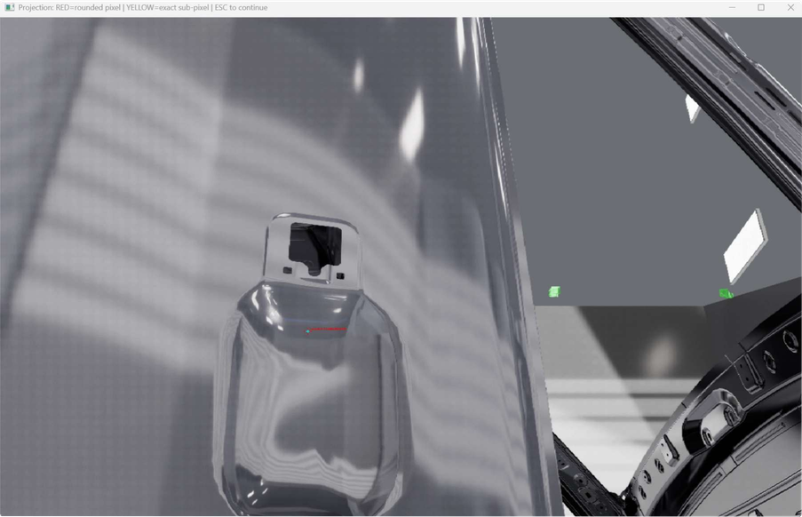
STUDY 1 · METHOD
A fully geometric pipeline
1
Click a ground-truth point
on the car surface in Isaac Sim — the exact 3D world coordinate is written to JSON.
2
Export pose & intrinsics
one atomic script exports camera intrinsics, camera pose and car pose from the same state.
3
Project & round
project the GT point to an exact sub-pixel (u*,v*), then round to the nearest integer pixel.
4
Back-project both rays
cast the sub-pixel ray and the pixel-centre ray and intersect each with the PLY mesh.
Projection viewer — RED rounded pixel vs YELLOW exact sub-pixel
5
Compare in Open3D
GREEN = ground-truth point, RED = rounded-pixel hit. Their distance is the 3D error.
The camera image is never processed — no detection artefact. Pixel rounding is the only place error enters.

Slide 6
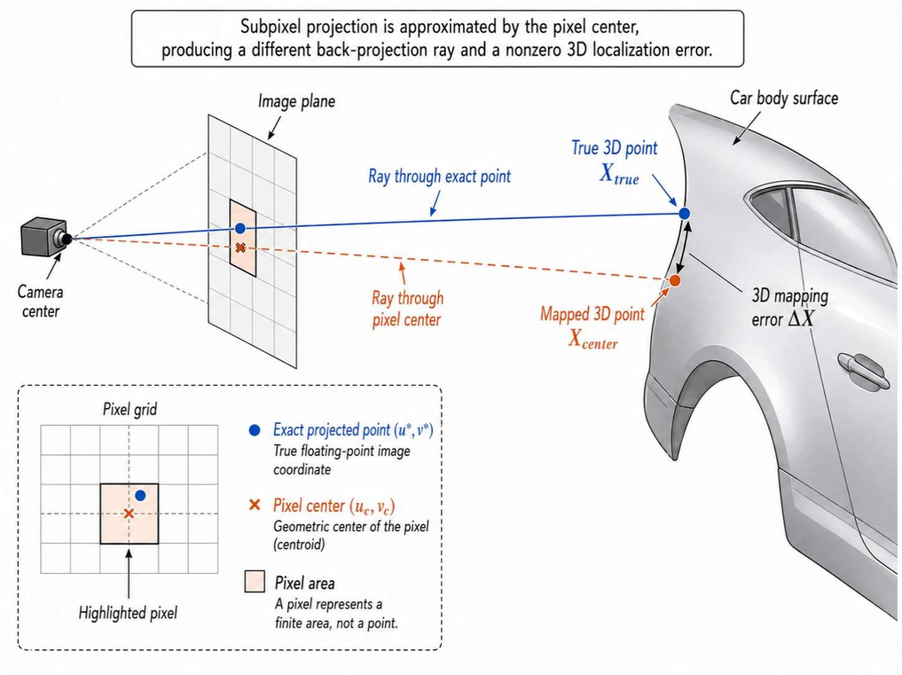
STUDY 1 · THE MATH
Rounding is the single error source
1 · Exact projection
u* = fx·(Xc/Zc) + cx
v* = fy·(Yc/Zc) + cy
exact floating-point image coordinate
2 · Rounding → the error
(u, v) = round(u*, v*)
2D error = |(u,v) - (u*,v*)|
3D error = meshHit(u,v) - X_true
A discrete pixel is a finite area, not a point —
its centre ray misses the true surface point.

Slide 7
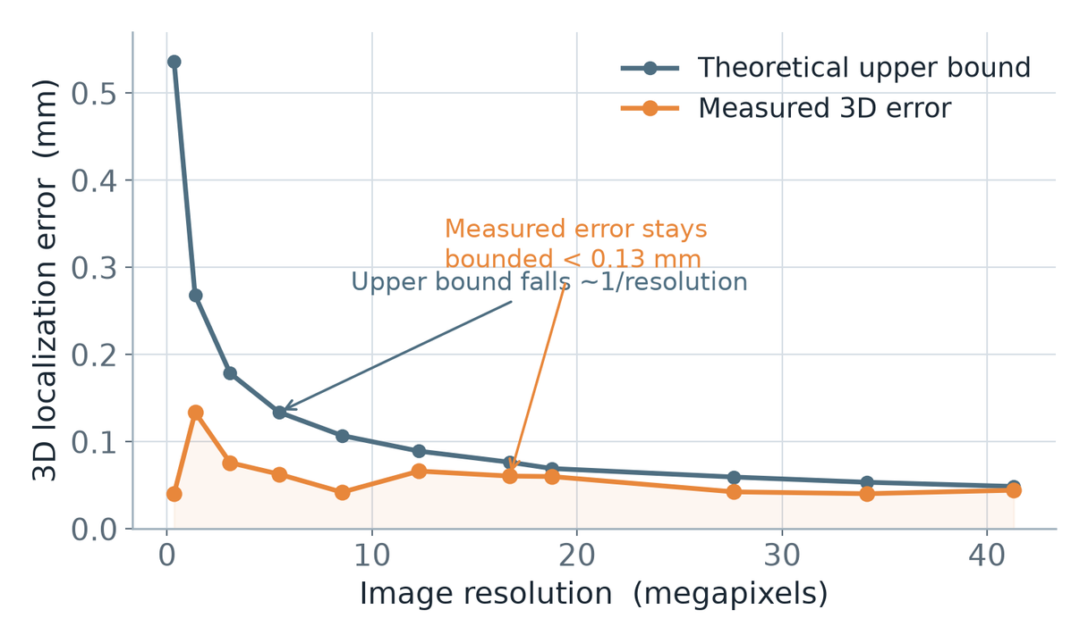
STUDY 1 · RESULTS
Resolution sets the ceiling, not the error
< 0.13 mm
measured 3D error across every resolution
0.05 mm
theoretical bound at 41 MP (0.54 mm at 0.3 MP)
Higher resolution shrinks the pixel, so the worst-case bound falls ~1/resolution.
But measured error is already far below the bound and does not fall monotonically.
Take-away: rounding is negligible at production resolution — not the bottleneck.
Experiment 1 — fixed pose & point, 11 resolutions (682×500 → 7509×5500)

Slide 8
02
Car-Pose
Sensitivity Heatmap
How pose-estimation error propagates into 3D projection error.

Slide 9
STUDY 2 · METHOD
Per-pixel error under pose deviation
Inputs
camera pose & intrinsics, ground-truth car pose, estimated car pose, image, CAD mesh (.ply).
Per pixel
cast the same ray at the actual pose and at the estimated pose; record both mesh hits.
Key design
compare each hit in its own CAD-local frame — measures genuine error, not a lateral shift.
Output
a heatmap of expected projection error (mm), with per-pixel inspect mode.
Example run — median error 1.00 mm
Projection-error heatmap overlaid on the car body (blue → red = 0 → 2 mm)

Slide 10
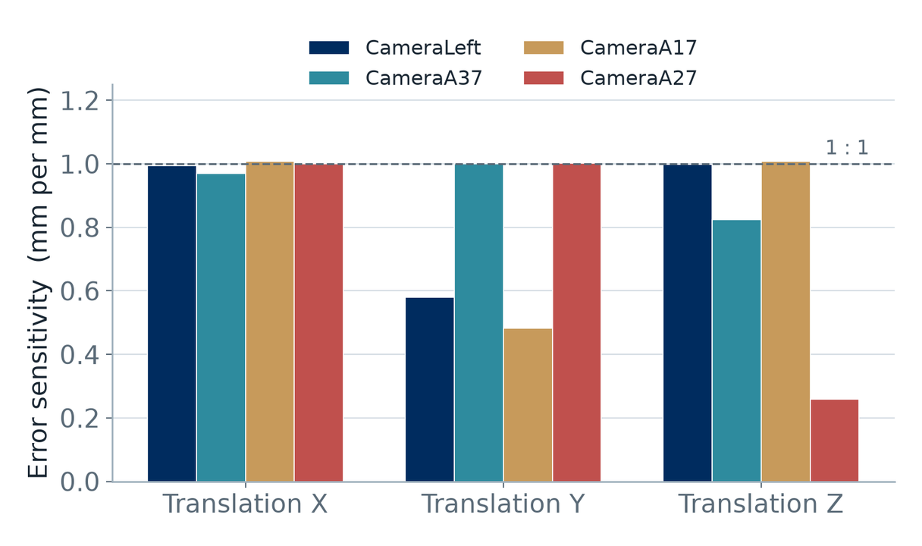
STUDY 2 · RESULTS
Translation error transfers ~1 : 1
≈ 1 mm
error per 1 mm of pose translation
Across all four camera viewpoints, the slope through the origin is ~0.5–1.0 mm/mm with R² ≈ 1.00.
The mapping is linear and highly predictable — no amplification.
A 1 mm car-position error yields roughly 1 mm of localization error.

Slide 11
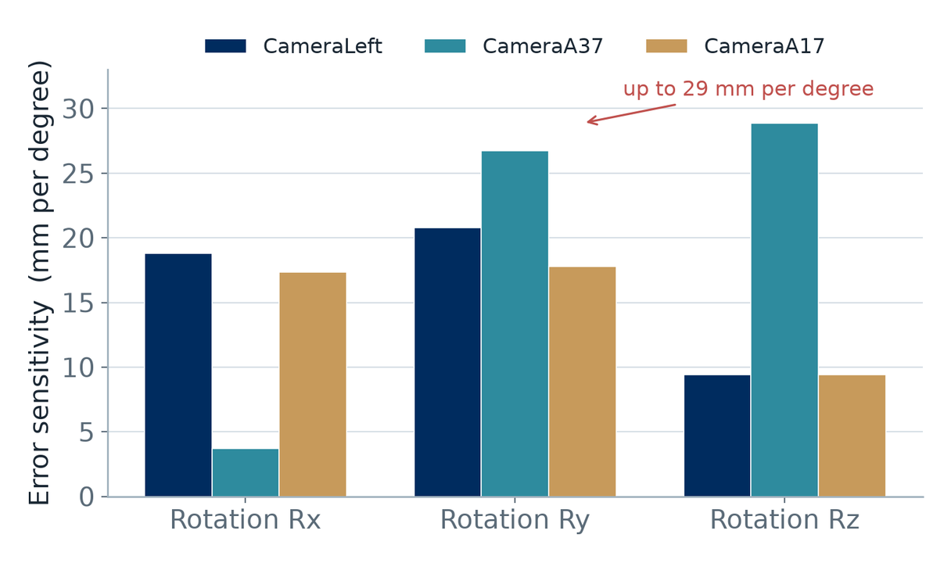
STUDY 2 · RESULTS
Rotation error dominates — by 1–2 orders of magnitude
9–29 mm
error per 1° of pose rotation
Rotation is 10–30× more punishing than translation per unit of pose error.
A 0.1° pose error already produces ~1–3 mm of localization error.
Ry and Rz are the most sensitive axes (up to 29 mm/°).

Slide 12
SYNTHESIS
What this means for the tolerance budget
Pixel rounding
Pose translation
Pose rotation
< 0.13 mm
~1 : 1
9–29 mm/°
Negligible at production resolution. Not the bottleneck — bank the margin.
Keep car-position error within your millimetre localization target.
The critical lever. Hold rotation error to ~0.05–0.1° for mm-level accuracy.
Bottom line: camera-pose rotation accuracy is the dominant driver of 3D localization error.

Slide 13
Summary & next steps
KEY FINDINGS
NEXT STEPS
Pixel rounding contributes < 0.13 mm — negligible; resolution only lowers the ceiling.
Tighten camera-extrinsics / pose estimation to sub-0.1° rotation.
Pose translation error transfers ~1:1 into 3D localization error.
Set a pose-accuracy spec from the sensitivity slopes per camera.
Pose rotation error dominates: 9–29 mm per degree across viewpoints.
Validate the tolerance budget on real captures, not only in sim.
0.1° of rotation ≈ 1–3 mm — the accuracy bottleneck for the MVP.
Fold both evaluators into the inline CAD-matching QA loop.
Hyundai Motor Group Innovation Center Singapore · Camera Extrinsics Calibration · haoyang.duan · Sprint 35

